Slide 1
PASSIVE VOICE

Slide 2
PASSIVE VOICE
Which of these sentences are in passive voice?
People throw tons of plastic into the ocean every year.
Tons of plastic are thrown into the ocean every year.
Factories pollute the air.
The air is polluted by factories.

Slide 3
PASSIVE VOICE
usage:
  when the action is more important than who or what does it
form:
    TO BE + past participle (-ed / 3rd form)
    ex. is kept
    are made
    was invented
    were designed
    will be asked

Slide 4
ACTIVE x PASSIVE
The OBJECT of an active sentence becomes the SUBJECT of the passive sentence.
ACTIVE SENTENCE
    = Subject – Active Verb – Object
    Planes produce greenhouse gases.
    PASSIVE SENTENCE
    = Subject – Passive verb (– Object)
    Greenhouse gases are produced (by planes).

Slide 5
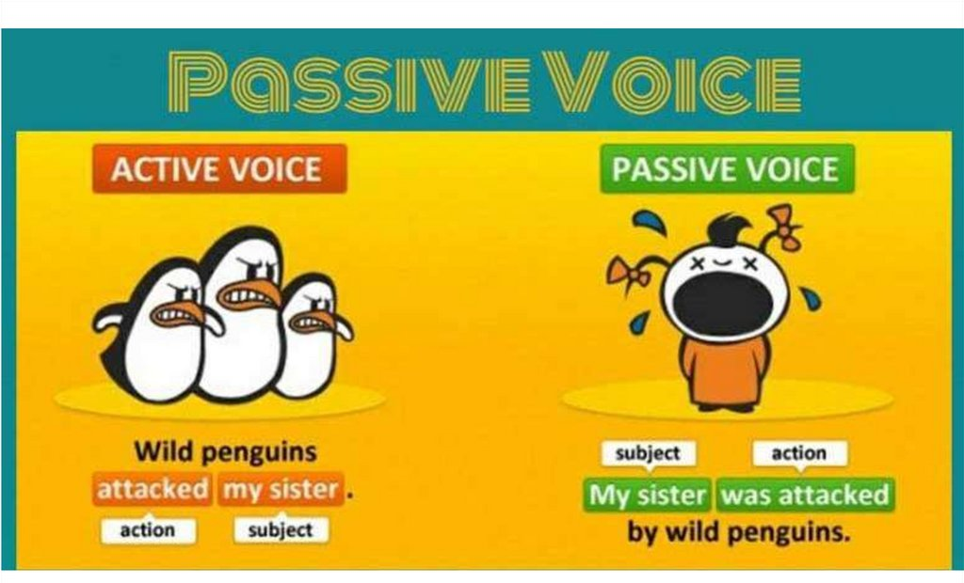

Slide 6
Put the active voice sentences into the passive voice.
Power stations burn fossil fuels.
Fossil fuels are burnt by power stations.
Cars produce CO2.
CO2 is produced by cars.
People cut down rainforests.
Rainforests are cut down.
Deforestation kills millions of animals.
Millions of animals are killed by deforestation.

Slide 7
Put the active voice sentences into the passive voice.
Sattelites photographed forest fire.
Forest fire was photographed by sattelites.
They sent endangered animals to zoos.
Endangered animals were sent to zoos.
Drought will change our environment.
Our environment will be changed by drought.
It won‘t destroy the world.
The world won‘t be destroyed.

