Slide 1
PRESENT PERFECT
= předpřítomný čas

Slide 2
SB: p. 57 – ex.4
I‘ve seen nearly all her films.
She hasn‘t done anything silly.
He‘s won lots of races.
I haven‘t seen a real Grand Prix.

Slide 3
Present Perfect
form:
HAVE(N‘T) / HAS(N‘T) + past participle
a) -ed (played, climbed)
b) 3rd form (done, seen, made)
usage:
  1) to talk about experiences in someone‘s life, without saying when it happened
    ex. We have seen the Tower of London.
    They‘ve won many races.
    She has seen all Star Wars movies.
    He‘s eaten a spider.

Slide 4
Předpřítomný čas
tvoření:
HAVE(N‘T) / HAS(N‘T) + past participle
a) -ed (played, climbed)
b) 3. sloupec (done, seen, made)
používáme:
  1) mluvíme-li o zážitcích a zkušenostech v životě, ale neuvádíme, kdy se staly
    ex. We have seen the Tower of London.
    They‘ve won many races.
    She has seen all Star Wars movies.
    He‘s eaten a spider.

Slide 5
 | have / has haven't /hasn‘t | past participle (-ed / 3rd form)
I | HAVE HAVEN‘T | climbed | a mountain.
You |  | played | baseball.
We |  | been | in the USA.
They |  | read | that book
He | HAS HASN‘T | visited | many countries
She |  | seen | the movie.
It |  | eaten | a snake.

Slide 6
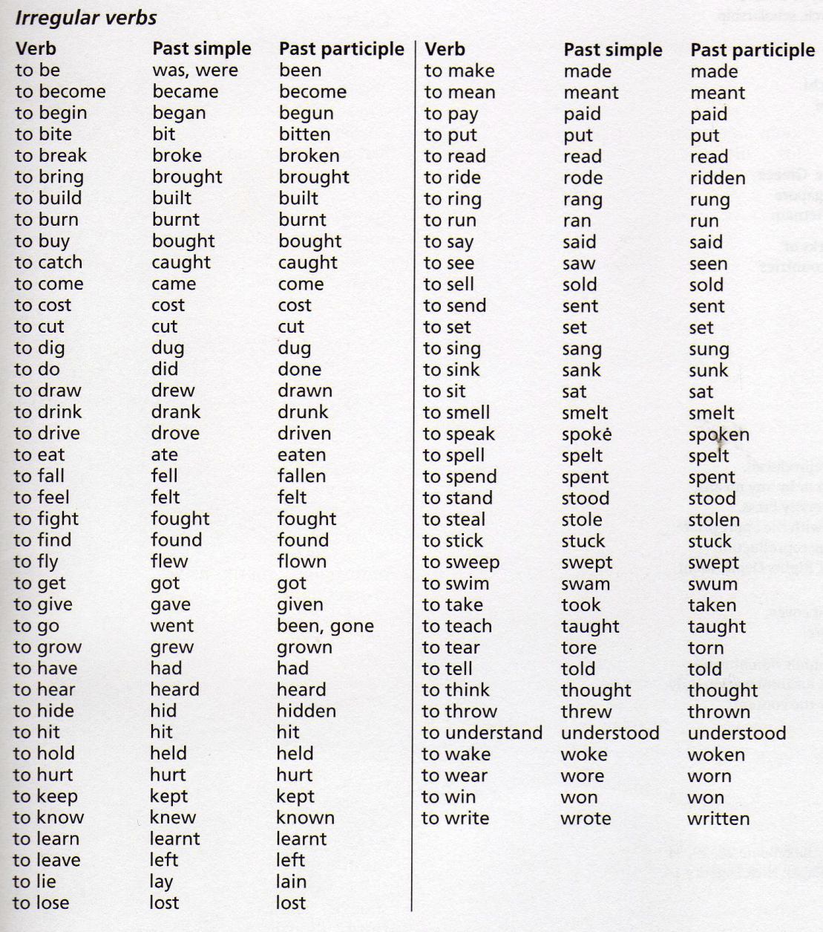
past participle
= 3. sloupec nepravidelných sloves
pracovní sešit str. 79

Slide 7
Which of these sentences are in Present Perfect?
Sally has given a lot of money to charity.
I gave some money to a homeless man yesterday.
I have visited many countries.
I visited Europe last year.
We‘ve won many tournaments.
We won the match last weekend.

