Slide 1

Present simple

Slide 2

I + verb (=sloveso)
Hello, friends!
My name is Andy.
I LIVE in Prague.
I GO to school.
I PLAY football.
I LIKE ice-cream.

Slide 3



We are Andy, Carol and Marc.
We LIVE in Prague.
We GO to school.
We LIKE English.
WE + verb (=sloveso)

Slide 4

YOU + verb (=sloveso)
You LIVE in Černošice.
You GO to school.
You DO homework.
You LIKE English.

Slide 5


I‘m Jane.
This is Andy and Carol.
They LIVE in Prague.
They GO to school.
THEY + verb (=sloveso)

Slide 6

HE + verb (=sloveso) + S
This is my friend Marc.
He LIVES in Prague.
He GOES to school.
He PLAYS tennis.
He LIKES animals.

Slide 7
SHE + verb (=sloveso) + S
This is my sister Carol.
She LIVES in Prague.
She GOES to school.
She PLAYS the flute.
She LIKES dolls.

Slide 8
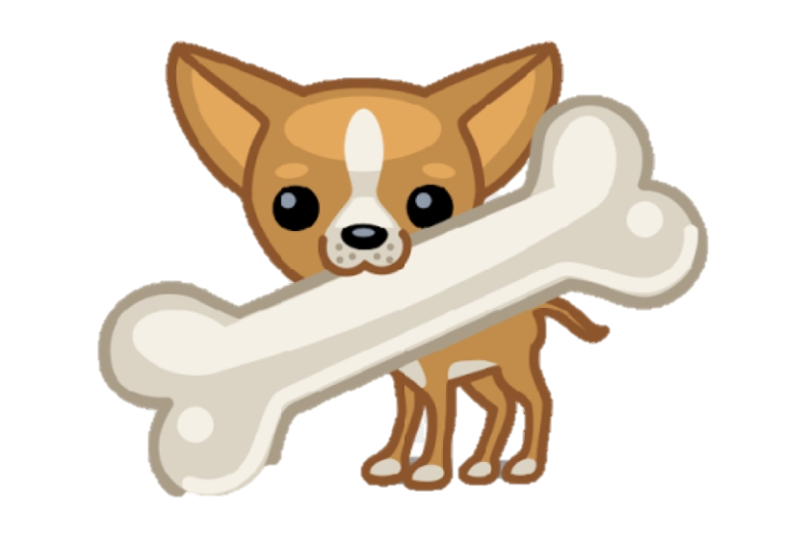
IT + verb (=sloveso) + S
This is a dog.
It LIVES in a house.
It PLAYS with a bone.
It LIKES cats.

Slide 9
 | present simple
I | like | rabbits.
He / She / It | likes (!!!) | dogs.
We | like | hamsters.
You | like | parrots.
They | like | spiders.

Slide 10
zápis:
PRESENT SIMPLE
(= přítomný čas prostý)
použití: každodenní činnosti
I
We
LIKE ice-cream.
You
They
He
She LIKES bananas.
It

