Slide 1

PRESENT SIMPLE:
QUESTIONS

Slide 2

_________ we study English?
Yes, _________.
Do
we do

Slide 3
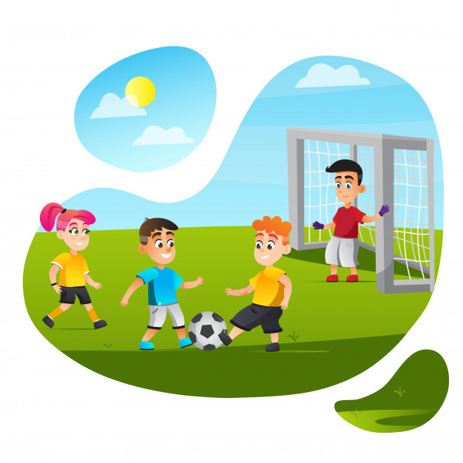
________ they play hockey every day?
No, __________.
Do
they don‘t

Slide 4
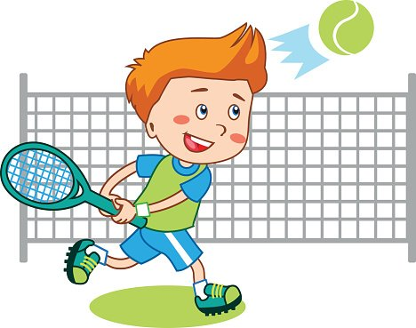
________ he do karate?
_____ ________.
Does
No, he doesn‘t

Slide 5
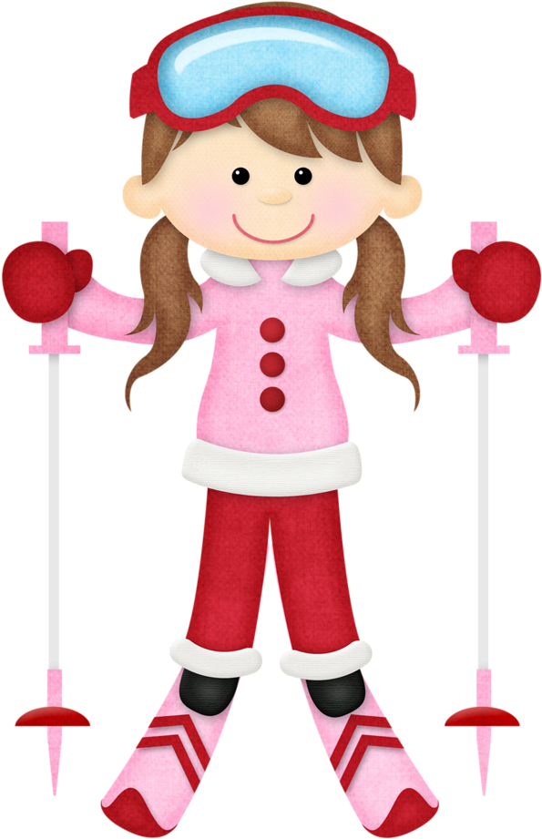
________ she go skiing?
______ ________.
Does
Yes, she does

Slide 6

________ Bart and Lisa go to school?
_____ ________.
Do
Yes, they do

Slide 7
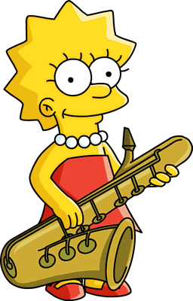
________ Lisa play the violin?
_____ ________.
Does
No, she doesn‘t

Slide 8
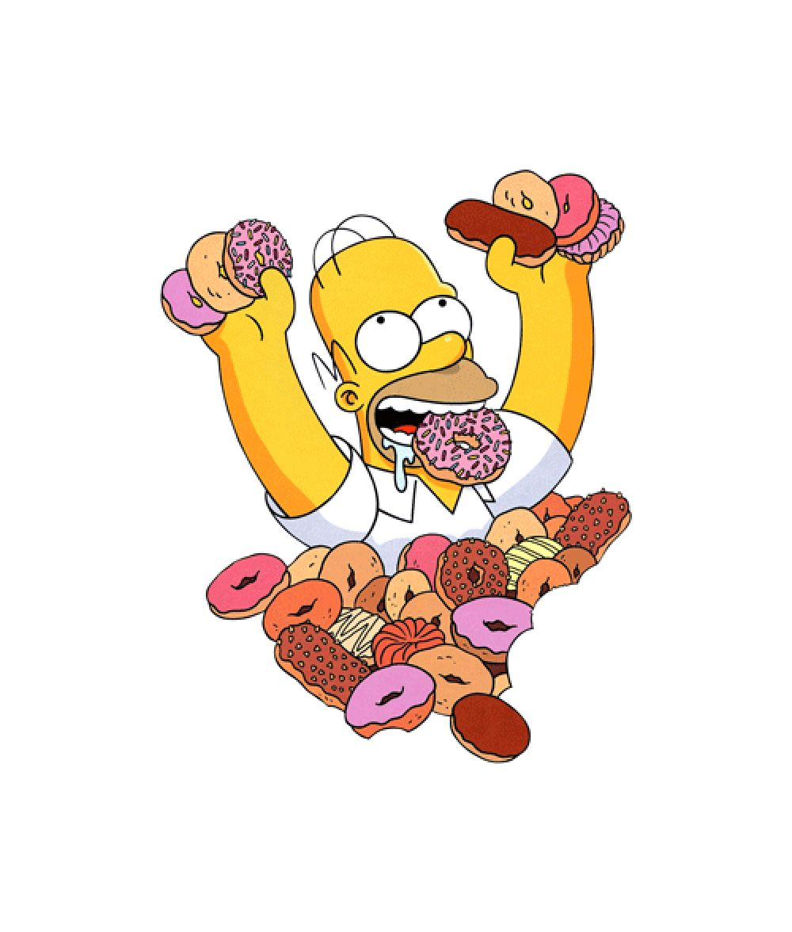
________ Homer like donuts?
_____ ________.
Does
Yes, he does

Slide 9
Tázací výrazy
WHO?
WHAT?
WHERE?
WHEN?
WHY?
HOW?
= kdo?
= co?
= kde?
= kdy?
= proč?
= jak?

Slide 10
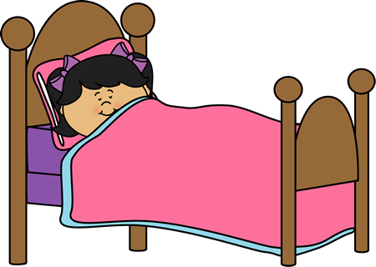
DOES SHE SLEEP?
Where_______________________
She sleeps in her bed.

Slide 11
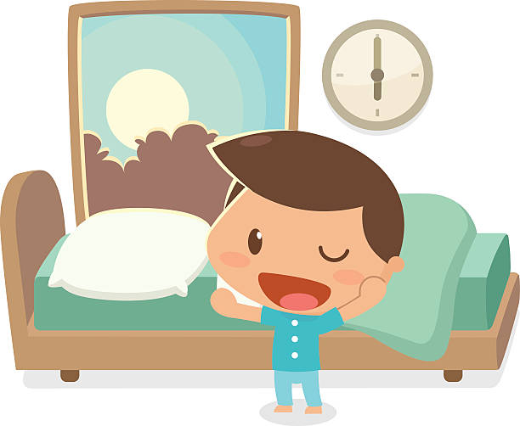
DOES HE GET UP?
When_______________________
he gets up at 6 o‘clock.

Slide 12
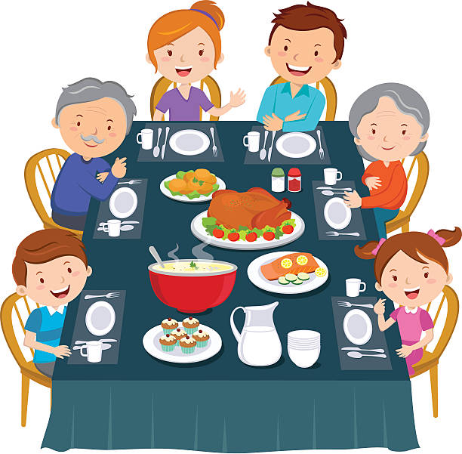
DO THEY EAT DINNER?
Where _______________________
They eat dinner in the kitchen.

Slide 13
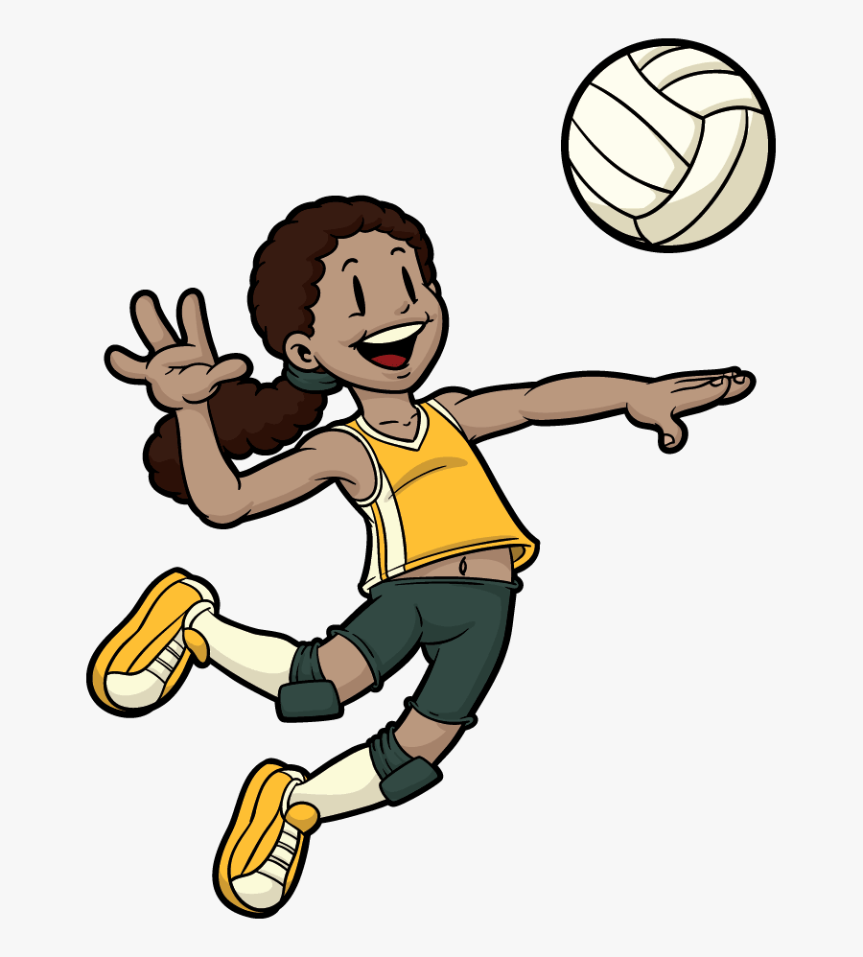
DOES MARY PLAY?
What _______________________
Mary plays volleyball.

Slide 14
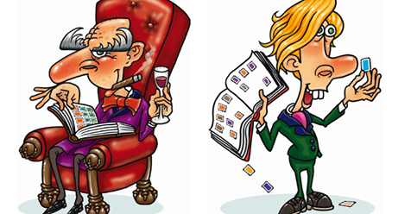
DO THEY COLLECT?
What_______________________
They collect stamps.

Slide 15
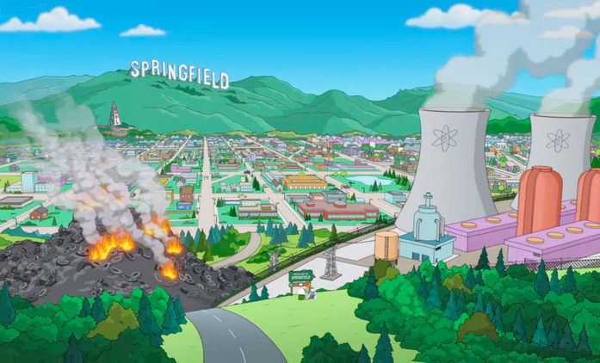
DO THE SIMPSONS LIVE?
Where_______________________
They live in springfield.

Slide 16
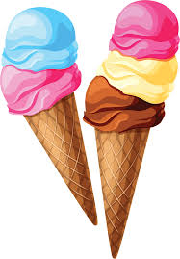
Do you like ice-cream?
Yes, I do.
No, I don‘t.

Slide 17

Do you play basketball?
Yes, I do.
No, I don‘t.

Slide 18
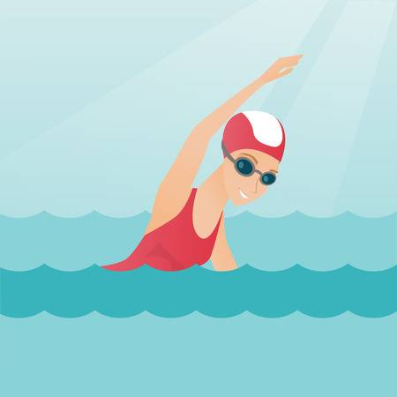
Do your parents go swimming?
Yes, they do.
No, they don‘t.

Slide 19
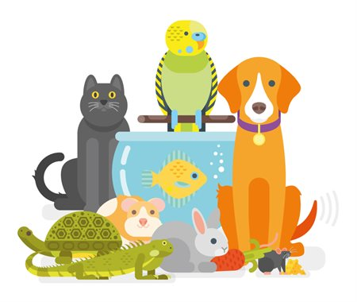
Does your pet play the flute?
No, it doesn‘t.

Slide 20
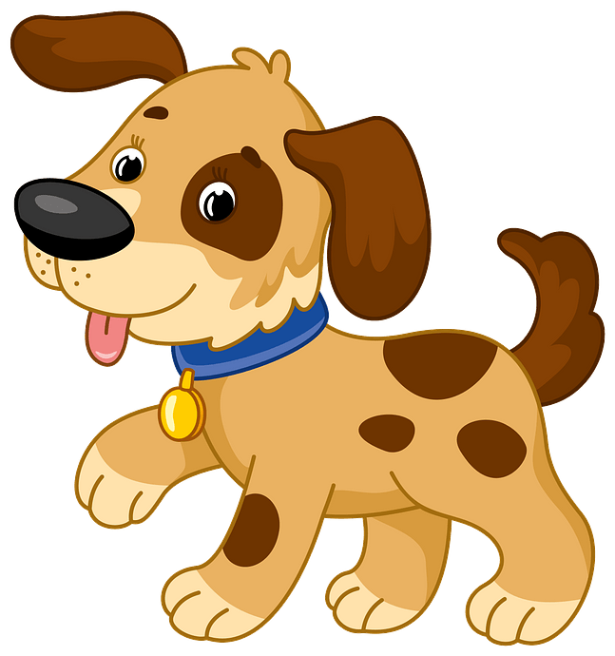
Does your mother like dogs?
Yes, she does.
No, she doesn‘t.

Slide 21


