Slide 1
PRESENT PERFECT
= předpřítomný čas

Slide 2
SB: p. 57 – ex.4
I‘ve seen nearly all her films.
She hasn‘t done anything silly.
He‘s won lots of races.
I haven‘t seen a real Grand Prix.

Slide 3
Present Perfect
form:
HAVE(N‘T) / HAS(N‘T) + past participle
a) -ed (played, climbed)
b) 3rd form (done, seen, made)
usage:
1) to talk about experiences in someone‘s life, without saying when it happened
ex. We have seen the Tower of London.
They‘ve won many races.
She has seen all Star Wars movies.
He‘s eaten a spider.

Slide 4
Předpřítomný čas
tvoření:
HAVE(N‘T) / HAS(N‘T) + past participle
a) -ed (played, climbed)
b) 3. sloupec (done, seen, made)
používáme:
1) mluvíme-li o zážitcích a zkušenostech v životě, ale neuvádíme, kdy se staly
ex. We have seen the Tower of London.
They‘ve won many races.
She has seen all Star Wars movies.
He‘s eaten a spider.

Slide 5
 | have / has haven't /hasn‘t | past participle (-ed / 3rd form)
I | HAVE HAVEN‘T | climbed | a mountain.
You |  | played | baseball.
We |  | been | in the USA.
They |  | read | that book
He | HAS HASN‘T | visited | many countries
She |  | seen | the movie.
It |  | eaten | a snake.

Slide 6
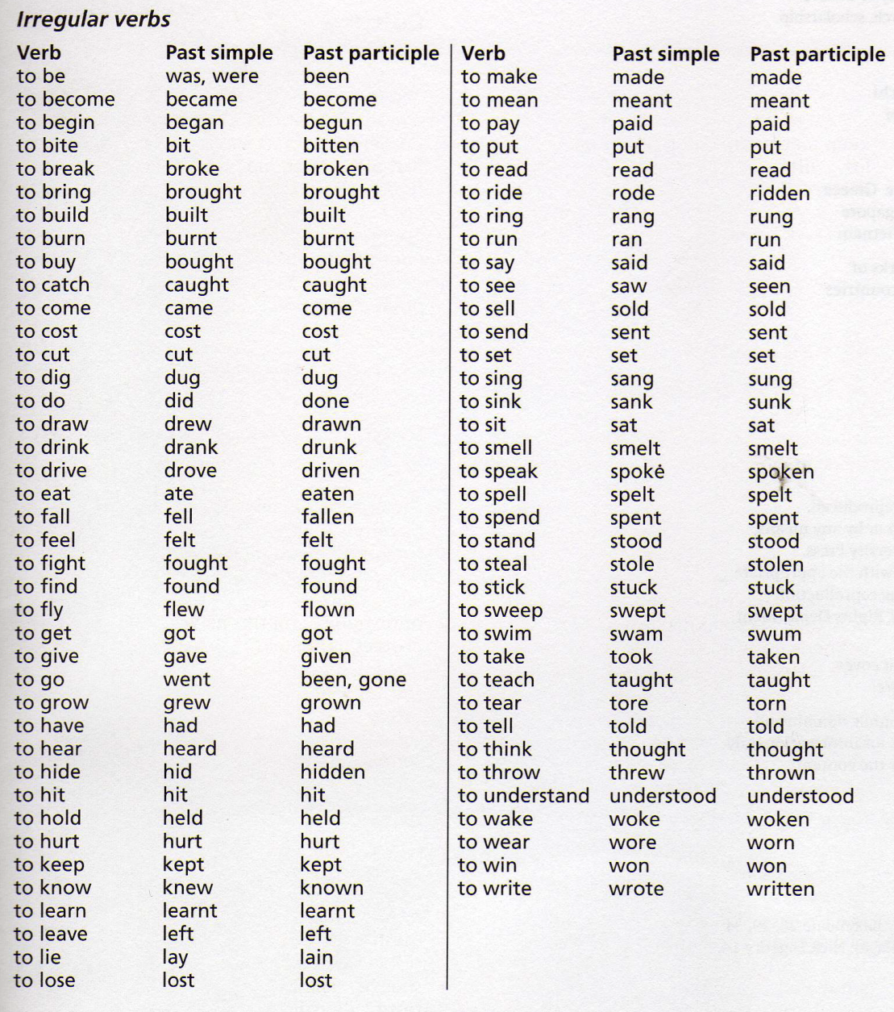
past participle = 3. sloupec nepravidelných sloves
pracovní sešit str. 79

Slide 7
Which of these sentences are in Present Perfect?
Sally has given a lot of money to charity.
I gave some money to a homeless man yesterday.
I have visited many countries.
I visited Europe last year.
We‘ve won many tournaments.
We won the match last weekend.

Slide 8
Wb.: p. 45 – ex. 5
She has painted….
They have found…
He has caught…
They have flown….
They have bought…
They have seen…

Slide 9
PRESENT PERFECT – question
Have / Has + subject + past participle …?
ex.
Have you tried bungee jumping?
Has he read that book?
Have your friends told you the secret?
Has Josh done his homework?

Slide 10
PRESENT PERFECT – question
have / has |  | past participle (-ed / 3rd form)
HAVE | I | climbed | a mountain?
 | you | played | baseball?
 | we | been | in the USA?
 | they | read | that book?
HAS | he | visited | many countries?
 | she | seen | the movie?
 | it | eaten | a snake?

Slide 11
PRESENT PERFECT – short answer
Have your parents (ever) visited Australia?
Yes, they have.
No, they haven‘t.
Has your best friend (ever) met anyone famous?
Yes, he has.
No, he hasn‘t.

Slide 12
PRESENT PERFECT – question
EVER (už někdy?)
used in: questions
meaning: up tu now
have / has + subject + EVER + past participle
ex. Have you EVER seen this film?
Has he EVER been in the USA?

Slide 13
PRESENT PERFECT
NEVER (nikdy)
used in: declarative sentences to express negative
meaning: not up to now
have / has + NEVER + past participle
ex. I have NEVER seen this film.
He has NEVER been in the USA.

